Slide 1

AI PROJECT
HOME
ABOUT
CONTENT
OTHERS
Customer Value Prediction & Customer Segmentation.
“The main business problem we’re addressing is that companies often don’t know who their most valuable customers are.
So our goal is to predict Customer Lifetime Value (CLV) and to segment customers based on their purchasing behavior.
This helps the business improve targeting, increase retention, and optimize marketing spending.”
Next Slide
team members

Slide 2

team members
1- MOATAZ ESSAM ABDELMONSEF (TEAM LEADER)
2- ZEINAB ALI AL_SAYED
3- SANA ELSAYED ELBAKRY
4- ESRAA MAGDY MOHAMMADY
5- NOUR HUSSIEN ALI

Slide 3

HOME
ABOUT
CONTENT
OTHERS
DATASET OVERVIEW
“IN THIS USER STORY, THE MAIN OBJECTIVE IS TO UNDERSTAND CUSTOMER BEHAVIOR AND SEGMENT CUSTOMERS BASED ON THEIR PURCHASING PATTERNS.
WE USED THE ONLINE RETAIL DATASET FROM UCI, WHICH CONTAINS OVER 541,000 TRANSACTIONS. THE FOCUS OF THE PROJECT IS TO ENGINEER MEANINGFUL FEATURES SUCH AS RFM, EXPLORE TRENDS,
BUILD CUSTOMER SEGMENTS, AND DEPLOY AN INTERACTIVE DASHBOARD.”
Next Slide
DATASET DESCRIPTION

Slide 4

HOME
ABOUT
CONTENT
OTHERS
Dataset Description
THE DATASET INCLUDES TRANSACTIONS FROM 2010 TO 2011, WITH FEATURES SUCH AS INVOICE NUMBER, DATE, QUANTITY, UNIT PRICE, CUSTOMER ID, AND COUNTRY.
BECAUSE THE DATASET DOES NOT PROVIDE A TARGET VARIABLE DIRECTLY, WE COMPUTED CUSTOMER LIFETIME VALUE OURSELVES AS:
CLV = FREQUENCYPERMONTH × AVERAGEORDERVALUE × 3 (LIFESPAN)
.
Next Slide

Slide 5
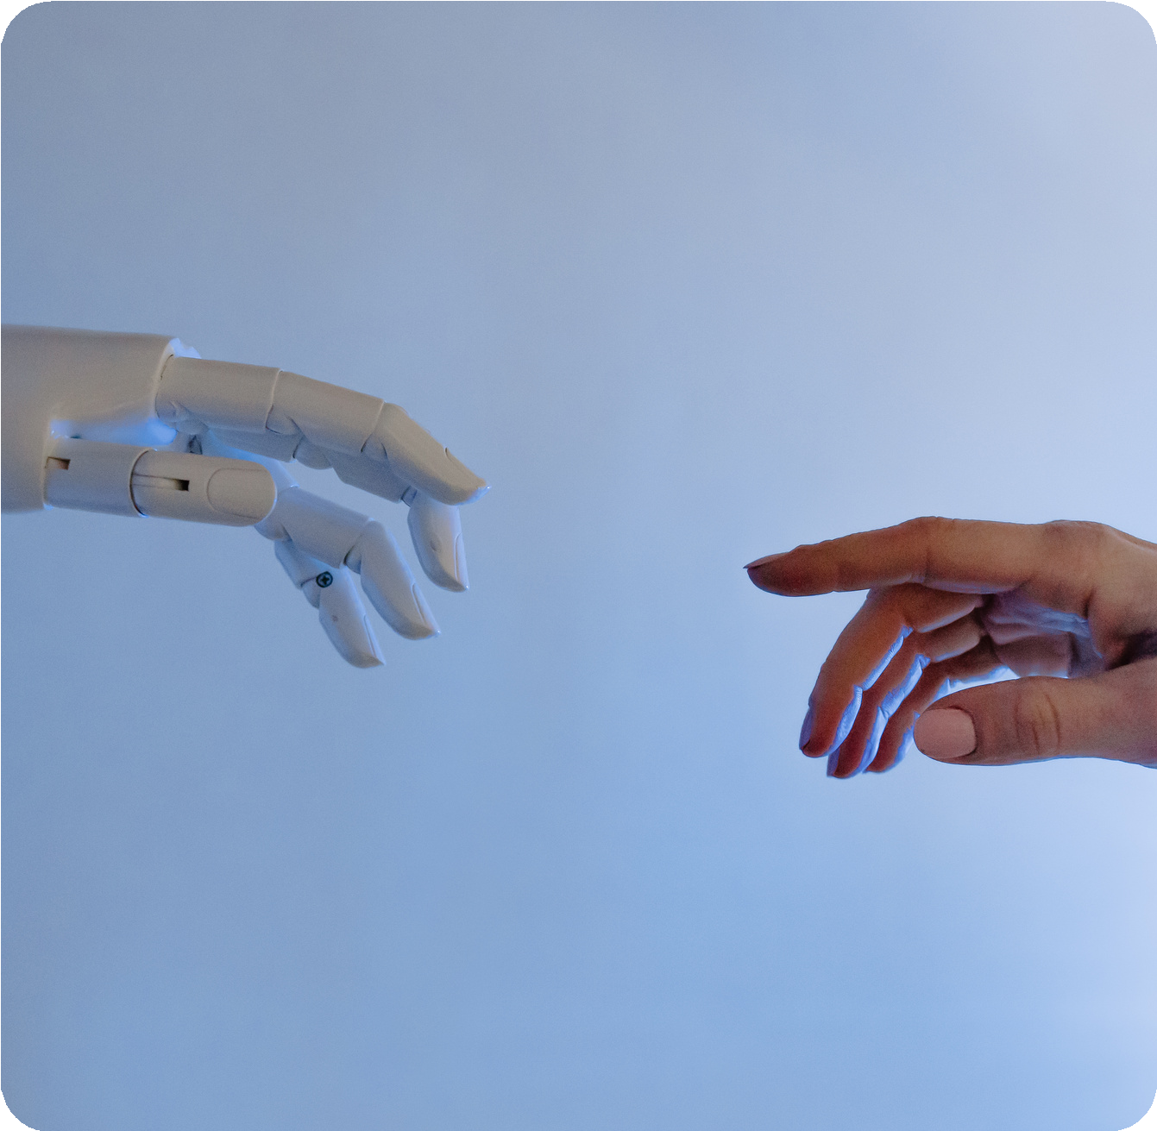
HOME
ABOUT
CONTENT
OTHERS
Data Cleaning & Preprocessing
IN PREPROCESSING, WE APPLIED SEVERAL ESSENTIAL STEPS:
1- DATA CLEANING:
REMOVED CANCELLED ORDERS (NEGATIVE QUANTITIES, INVOICENO STARTING WITH “C”).
FILLED MISSING CUSTOMERIDS BY ASSIGNING UNIQUE GENERATED IDS (KEPT ALL RECORDS INSTEAD OF DROPPING ~135K ROWS).
REMOVED DUPLICATES AND FIXED INCONSISTENT DATA TYPES.
2- CLV CALCULATION USED:
1- CLV = FREQUENCYPERMONTH × AVERAGEORDERVALUE × 3 (LIFESPAN)
APPLIED RECENCY ADJUSTMENT:
CLV = CLV × 1/(RECENCYMONTH + 1)
“GIVES HIGHER VALUE TO ACTIVE CUSTOMERS AND LOWER VALUE TO INACTIVE ONES”.

Slide 6
HOME
ABOUT
CONTENT
OTHERS
Data Cleaning & Preprocessing
IN PREPROCESSING, WE APPLIED SEVERAL ESSENTIAL STEPS:
3- RFM FEATURE ENGINEERING
RECENCY: DAYS SINCE EACH CUSTOMER’S LAST PURCHASE.
FREQUENCY: NUMBER OF TRANSACTIONS PER CUSTOMER.
MONETARY: TOTAL SPENDING AMOUNT.
TEMPORAL FEATURES (FROM INVOICEDATE) EXTRACTED:
HOUR OF DAY
DAY OF WEEK
MONTH
SEASON
“THESE STEPS ENSURED THE DATASET WAS CONSISTENT AND READY FOR ANALYSIS AND MODELING”

Slide 7
HOME
ABOUT
CONTENT
OTHERS
Data Cleaning & Preprocessing
IN PREPROCESSING, WE APPLIED SEVERAL ESSENTIAL STEPS:
5- PRODUCT-BASED FEATURES
CREATED PRODUCT CATEGORY FROM THE DESCRIPTION COLUMN USING TEXT GROUPING.
CALCULATED PRODUCT DIVERSITY FROM STOCKCODE (NUMBER OF UNIQUE PRODUCTS PURCHASED PER CUSTOMER).
6- HANDLING CATEGORICAL VARIABLES
ENCODED CATEGORICAL FEATURES INCLUDING:
COUNTRY
PRODUCT CATEGORY
“THESE STEPS ENSURED THE DATASET WAS CONSISTENT AND READY FOR ANALYSIS AND MODELING”

Slide 8
HOME
ABOUT
CONTENT
OTHERS
Data Cleaning & Preprocessing
IN PREPROCESSING, WE APPLIED SEVERAL ESSENTIAL STEPS:
7- NORMALIZATION
APPLIED LOG TRANSFORMATION (NP.LOG) TO NUMERIC FEATURES.
PURPOSE:
REDUCE SKEWNESS IN DATA.
SCALE LARGE VALUES FOR BETTER MODEL PERFORMANCE.
“THESE STEPS ENSURED THE DATASET WAS CONSISTENT AND READY FOR ANALYSIS AND MODELING”

Slide 9

Exploratory Data Analysis
HOME
ABOUT CONTENT OTHERS
FOR EDA, WE EXPLORED SEVERAL BUSINESS-CRITICAL PATTERNS:
Customer Distribution by Country Time-Series Analysis (2010–2011)
Customer Lifetime Value (CLV) & Pareto (80/20) Analysis RFM Analysis (Recency, Frequency, Monetary)
Product Popularity (StockCode & Description) Cohort Analysis (Customer Retention) Seasonality & Peak Purchasing Patterns Geographic Spending Behavior
“THIS ANALYSIS HELPED US UNDERSTAND THE STRUCTURE OF THE BUSINESS AND IDENTIFY HIGH-VALUE SEGMENTS”

Slide 10

THYNK
UNLIMITED.
HOME
ABOUT
CONTENT
OTHERS
ML models
(OPTIONAL SMALL MENTION) SUPERVISED LEARNING
We trained a few regression models mainly to complete the project structure
UNSUPERVISED LEARNING: K-MEANS CLUSTERING
FOR CUSTOMER SEGMENTATION, WE APPLIED K-MEANS CLUSTERING ON RFM FEATURES. AFTER TESTING DIFFERENT VALUES OF K, WE SELECTED K = 5, WHICH GAVE WELL- SEPARATED AND MEANINGFUL CUSTOMER GROUPS
“WE ANALYZED EACH CLUSTER BASED ON SPENDING BEHAVIOR, PURCHASING FREQUENCY, AND RECENCY”

Slide 11

THYNK
UNLIMITED.
HOME
ABOUT
CONTENT
OTHERS
Unsupervised ML
PCA for Visualization
We used Principal Component Analysis (PCA) to reduce the RFM features from 3 dimensions to 2 components.
Next Slide
This allowed us to visualize the clusters clearly.
CLUSTER PROFILES
“The PCA plot showed distinct group separation, confirming that our segmentation captures real behavioral patterns.”

Slide 12
HOME
ABOUT
CONTENT
OTHERS
Unsupervised ML
Cluster Profiles
BASED ON THE CLUSTERING RESULTS:
CLUSTER 0 → LOW-VALUE CUSTOMERS
CLUSTER 1 → HIGH-FREQUENCY, HIGH-VALUE CUSTOMERS (VIPS)
CLUSTER 2 → NEW OR OCCASIONAL BUYERS
CLUSTER 3 → CUSTOMERS WITH HIGH MONETARY VALUE BUT LOW FREQUENCY
CLUSTER 4 → RECENTLY ACTIVE CUSTOMERS WITH MODERATE SPENDING
-
“THESE CLUSTER PERSONAS HELP THE BUSINESS DESIGN TARGETED MARKETING STRATEGIES”

Slide 13
HOME
ABOUT
CONTENT
OTHERS
Deep Learning Model
WE ALSO DEVELOPED A DEEP NEURAL NETWORK (DNN) TO ENHANCE CLV PREDICTION AND LEARN MORE COMPLEX CUSTOMER PATTERNS.
THE MODEL INCLUDED MULTIPLE HIDDEN LAYERS WITH DROPOUT AND BATCH NORMALIZATION TO AVOID OVERFITTING.
“ ALTHOUGH DEEP LEARNING WAS NOT THE PRIM₋ARY FOCUS, IT ALLOWED US TO COMPARE TRADITIONAL RFM-BASED INSIGHTS WITH LEARNED REPRESENTATIONS”

Slide 14
HOME
ABOUT
CONTENT
OTHERS
Streamlit Deployment
WE DEPLOYED THE ENTIRE PIPELINE IN A STREAMLIT DASHBOARD THAT INCLUDES:
CUSTOMER LOOKUP WITH REAL-TIME CLV PREDICTION
INTERACTIVE SEGMENTATION EXPLORER
RFM SCORING AND FILTERS
CLUSTER VISUALIZATION
PRODUCT AND CUSTOMER INSIGHTS
DOWNLOADABLE CUSTOMER LISTS FOR TARGETED MARKETING CAMPAIGNS
“THIS MAKES THE SYSTEM ACCESSIBLE AND USEFUL FOR NON-TECHNICAL BUSINESS TEAMS”
-

Slide 15
Business Impact
THE PROJECT PROVIDES VALUABLE INSIGHTS FOR THE COMPANY
HOME ABOUT CONTENT
OTHERS
IDENTIFY AND PRIORITIZE HIGH-VALUE CUSTOMERS BUILD PERSONALIZED MARKETING STRATEGIES IMPROVE RETENTION AND ENGAGEMENT
PREDICT CUSTOMER VALUE MORE ACCURATELY VISUALIZE CUSTOMER BEHAVIOR IN A SIMPLE DASHBOARD
-

Slide 16
HOME
ABOUT
CONTENT
OTHERS
Conclusion
TO SUMMARIZE, WE COMPLETED A FULL PIPELINE FROM PREPROCESSING TO DEPLOYMENT.
OUR MAIN FOCUS WAS UNDERSTANDING CUSTOMER BEHAVIOR, BUILDING MEANINGFUL SEGMENTS, AND DELIVERING INSIGHTS THAT HELP THE BUSINESS IMPROVE DECISION-MAKING.
-

Slide 17

Thank you

